Slide 1


FCM Master data audit 2023
FCM Supply Chain - Operations
02.Feb.2023
5acXjzUk

Slide 2
Agenda
1
Master data Auditing Target
2
2023 Auditing Plan for FCM

Slide 3
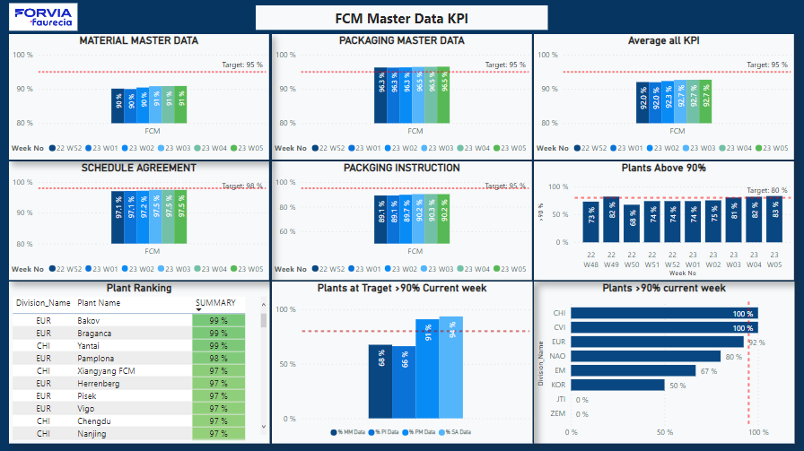
Master data Auditing Target
Objective:
Make sure the Master Data KPIs which collected from SAP system are true/reality
Make sure the Master Data KPIs calculating process of SAP system are correct
Maintain the Accuracy and Consistency
Results: We are 100% confident with the Master Data KPIs that collected from SAP Plant level, and we could trust the centralized KPI Dashboard showing weekly like below

Slide 4
Accuracy result - explanation
Accuracy means :
the data value is the correct one.
Some examples :
Minimum lot size is equal to production batch constraint on the shopfloor.
Parts weights are equal to the real weights.

Slide 5
Consistency result - explanation
Consistency means :
the data format is correct or that the data is correct compared to other data.
Some examples :
Rounding value is matching with packaging quantities
Parts weights are similar on material master (MM03) and purchasing schedule agreement (ME32L)
MRP profile is aligned with the part classification (meaning finished good is setup as finished good, component is setup as component).

Slide 6
Agenda
1
Master data Auditing Target
2
2023 Auditing Plan for FCM

Slide 7
Master data Auditing Plan of 2023
Auditing Tools involved:
Materials List of auditing should be prepared to be compared the truth/reality number vs. SAP number
RPA robot could automatically retrieve data from SAP system
Auditing People involved:
One delegate from DRF team will take the lead of the annual auditing plan, and he/she will be also needed to track the auditing process through the camera
RPA team will take charge of RPA robot operation
Division and Plant support will be needed correspondingly

Slide 8
Master data Auditing Plan of 2023
Auditing Process:
Prepared material lists of auditing for plants and send file before starting audit process
Count the number and check the authenticity of the current SAP result
Enter random number in the SAP system to check the calculation process is correct
(77*2)/43= 3.58
Involved upcoming day-off and vacation,
We would audit 3 plants per week having day-off, We would audit 4 plants per normal week
Auditing Year Plan:
77 Plants
2 Auditing per plant per year
43 rest work weeks of 2023 (W08 to W50)
Note: W06 and W07 will test the RPA tools and confirmed with division of the auditing time
8+(43/2)=29.5
W30 with be the mid-term of the auditing
=> Until 24th July, all 77 plants should already be audited one time

Slide 9
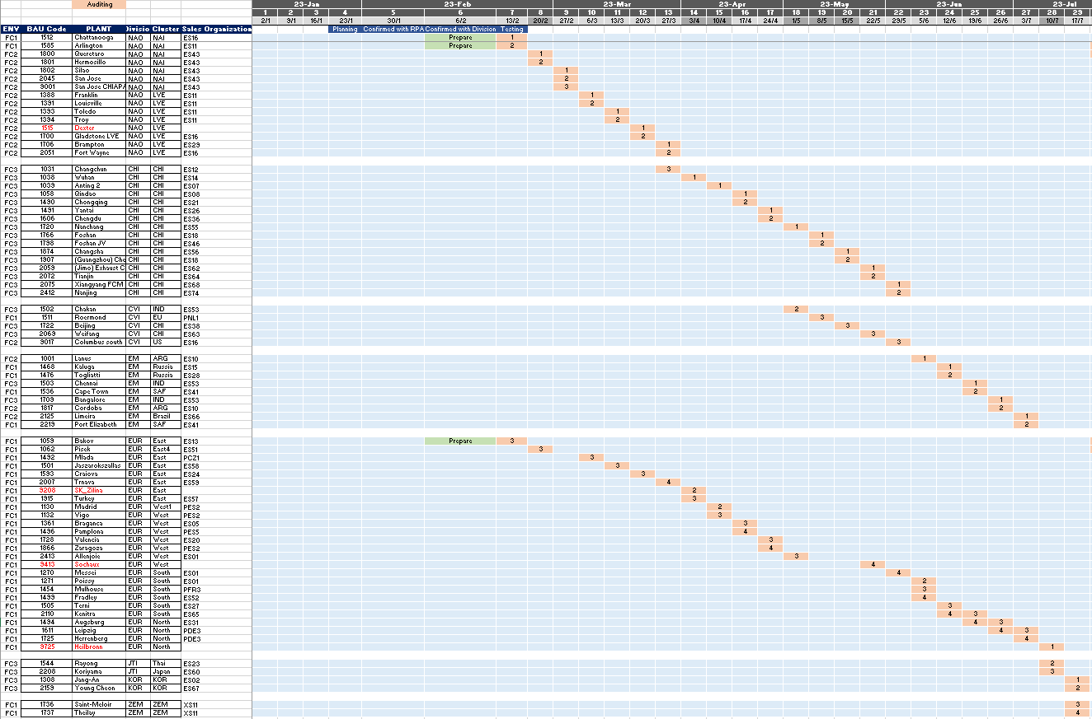
Master data Auditing Plan of 2023
Auditing Year Plan in general view: Feb to Jul

Slide 10
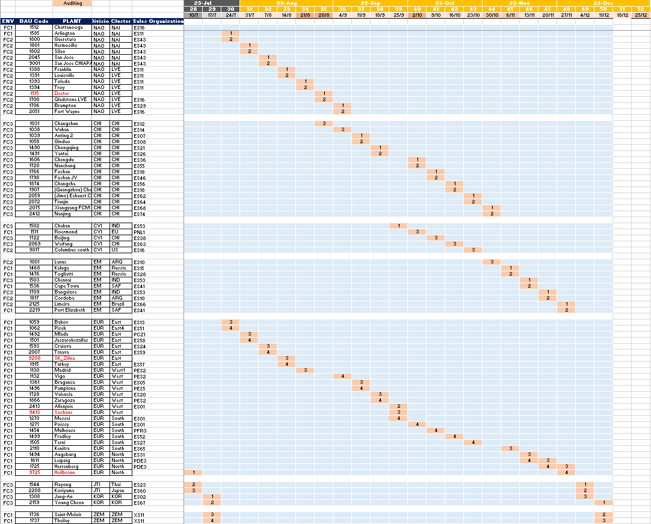
Master data Auditing Plan of 2023
Auditing Year Plan in general view: Feb to Jul

